Slide 1
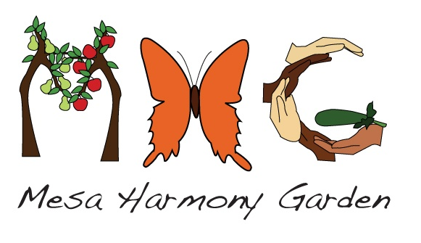

Slide 2
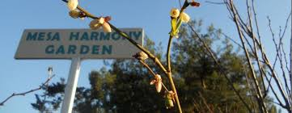
MESA HARMONY GARDEN
Volunteer-led non-profit
Community food forest
Permaculture demonstration site
Growing for the Food Bank
Learning resource
Community gathering place
Template for urban foodscapes

Slide 3
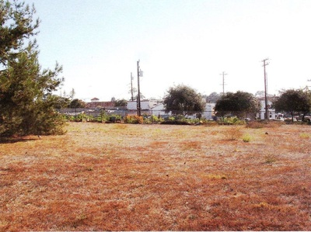
BEFORE (2010)
Notes:
The land belongs to the catholic archdiocese of Los Angeles, adjacent to the holy cross church in the Mesa neighborhood of Santa Barbara. It stood empty for 40 years prior to work starting on MHG.

Slide 4
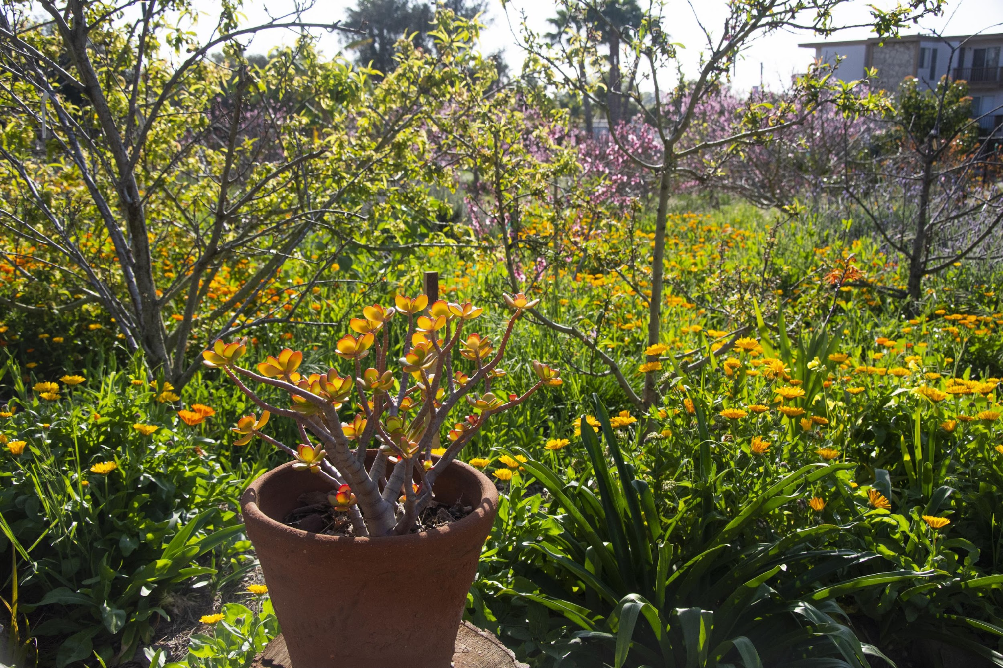
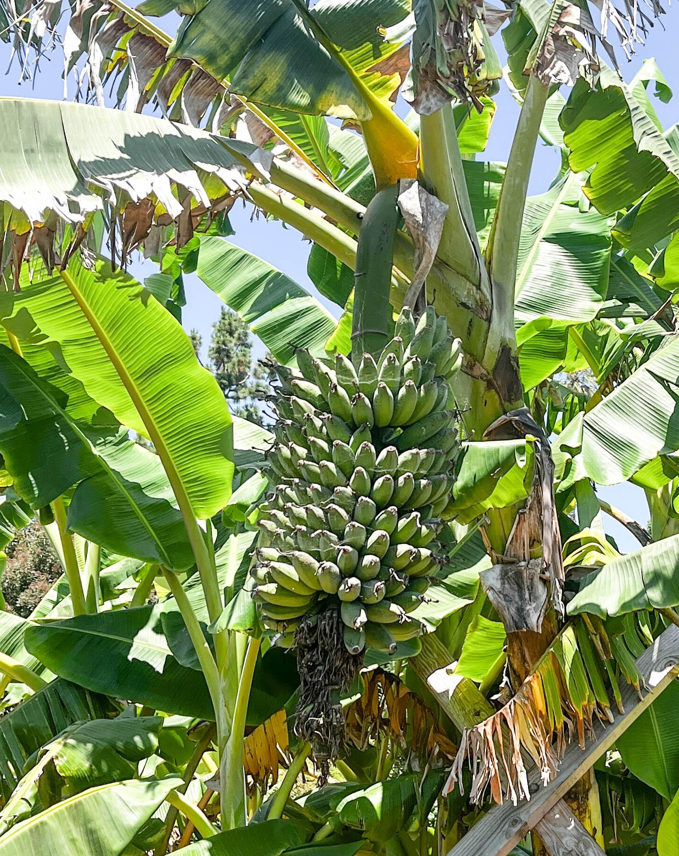
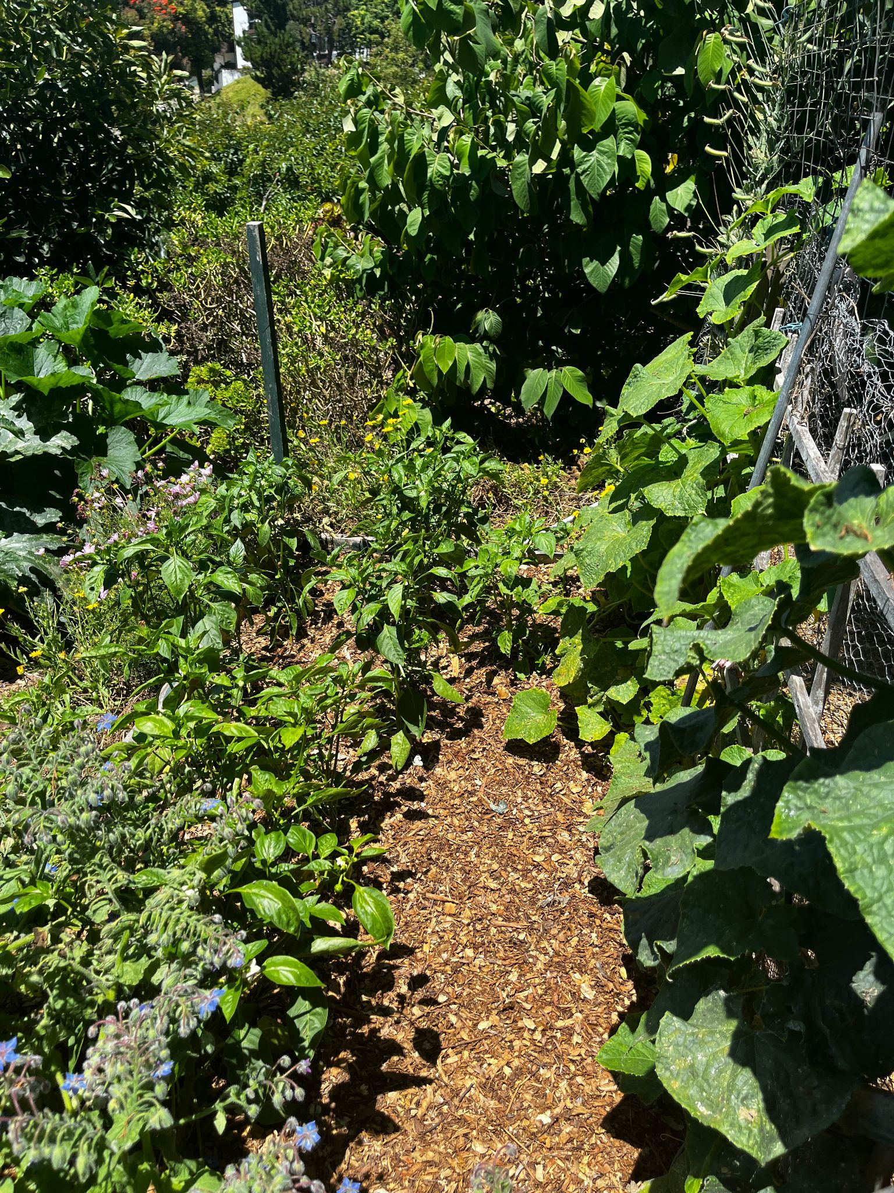
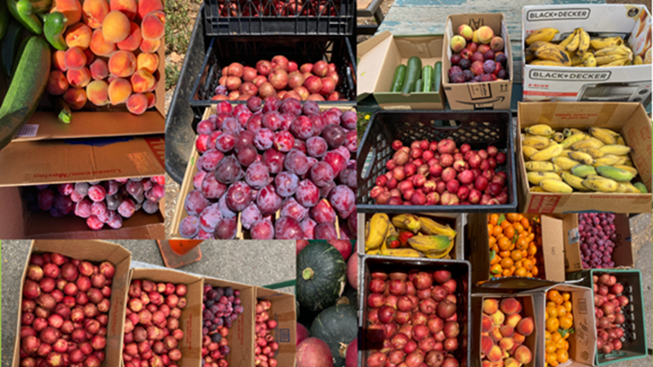
BEFORE 2010
NOW
Notes:
Back in 2010, after 40 years of trying to come up with a plan for the land, suddenly it all started to come together…
- the parish council was exploring ideas for a community gathering space of some kind.
- some students at city college doing a class called ‘projects in sustainability’ were looking for a site for a demonstration garden
- they approached the parish and their ideas were warmly greeted
- they also approached Larry Saltzman, a local expert on Mediterranean food forests, and he agreed to design a food forest for the site,
- a few days later, Larry ran into someone from the Food Bank who had just received a grant for 80 fruit trees
- all that was needed was the people to turn the idea into a reality…

Slide 5
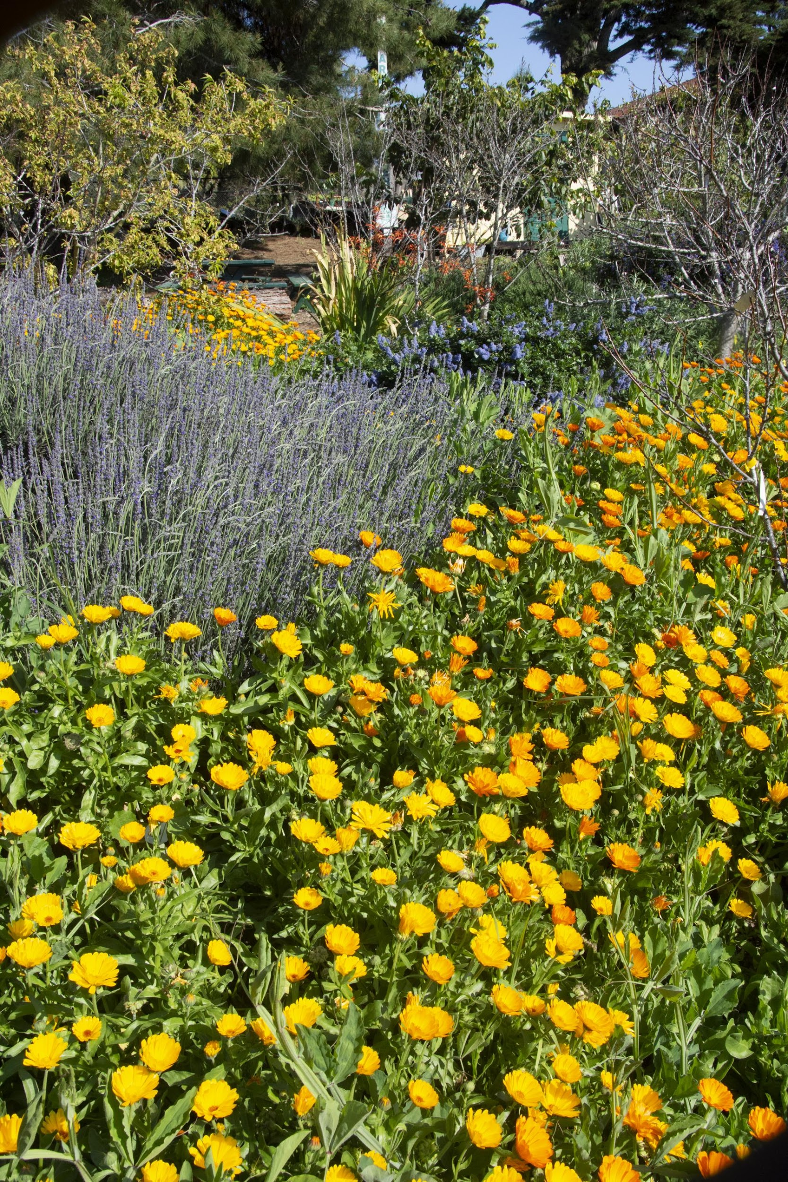
HOW DO WE KEEP IT GOING?
Board of directors.
Core group of “regulars.”
Work-group leaders.
Weekly work-party leaders.
VOLUNTEERS!!!
Donations from local community members and organizations to meet the costs of planting, watering, maintenance, and insurance.
www.mesaharmonygarden.org/qd

Slide 6
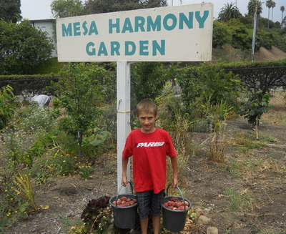
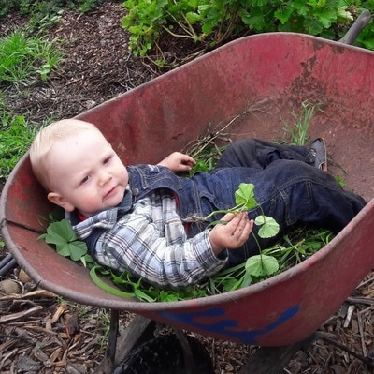
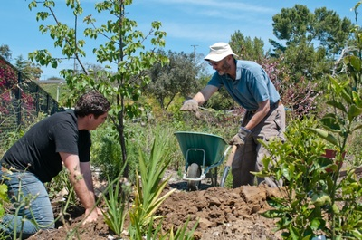
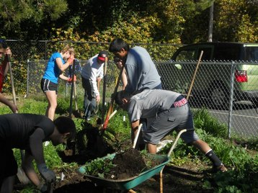
VOLUNTEERS TAKE PART IN REGULAR WORK-PARTIES TO PLANT AND MAINTAIN THE GARDEN.
Volunteer work teams include composting, tree-care, irrigation, gopher control, beautification, perennial vegetables, and understory plants.
Volunteers receive practical instruction and invaluable experience, and they get the chance to make a contribution
Every Saturday morning 9:00-12:00

Slide 7
HARD WORK…AND VISION!
So much has gone into to making MHG what it is today:
Finding a site
Grading
Garden design
Acquiring over 100 trees!
Planting
Keeping ahead of the weeds!!
Installing an irrigation system
Setting up a water catchment system
Installing Flume to notify of leaks and monitor water use
And so much more….

Slide 8
WHAT IS PERMACULTURE?
Garden Design - Incorporating Permaculture from the Beginning
“Permaculture is a design process, based in observation and systems thinking, that helps people to create ecologically and socially sustainable human settlements.”
The design principles are extremely accessible and universally applicable prompts to insightful thought and action.
They include, for example:
- Obtain a Yield
- Produce No Waste
- Use Small, Slow Solutions
- Creatively Use and Respond to Change
https://oaec.org/our-work/projects-and-partnerships/permaculture/what-is-permaculture/
https://www.familyfoodgarden.com/food-forest-plant-guilds-permaculture-design/
Notes:
Permaculture designers use our growing understanding of complex interconnections in the natural world to create food systems that mimic nature. We hope to combine present-day knowledge with the lessons of the past, learning from the many different cultures all over the world, going back thousands of years, who have devised food systems that worked in harmony with nature. Rather than visualising agriculture as an industrial process, we are relearning that natural resources have to be regenerated, not just consumed.

Slide 9
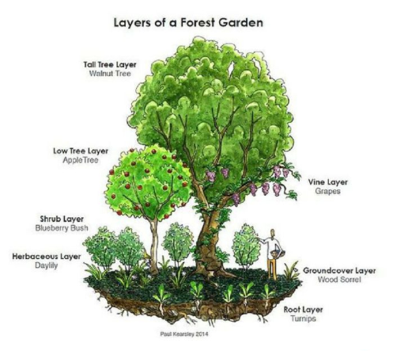
Incorporating FOOD FOREST principles from the beginning…
https://www.familyfoodgarden.com/food-forest-plant-guilds-permaculture-design/

Slide 10
Incorporating Plant guilds… * Nitrogen fixers * Pollinator plants * Deep-rooted plants * Mulchers * Repellers * Suppressors

Slide 11
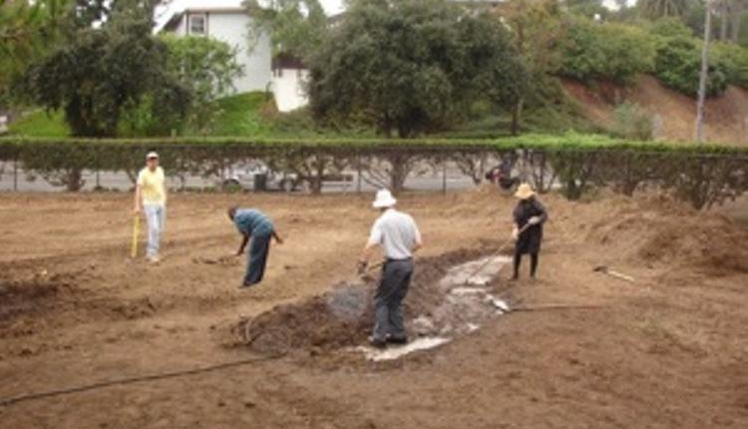
2010: FIRST VOLUNTEER DAY

Slide 12
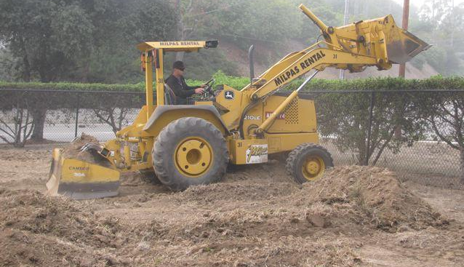
2010: PROBLEM SOLVED

Slide 13
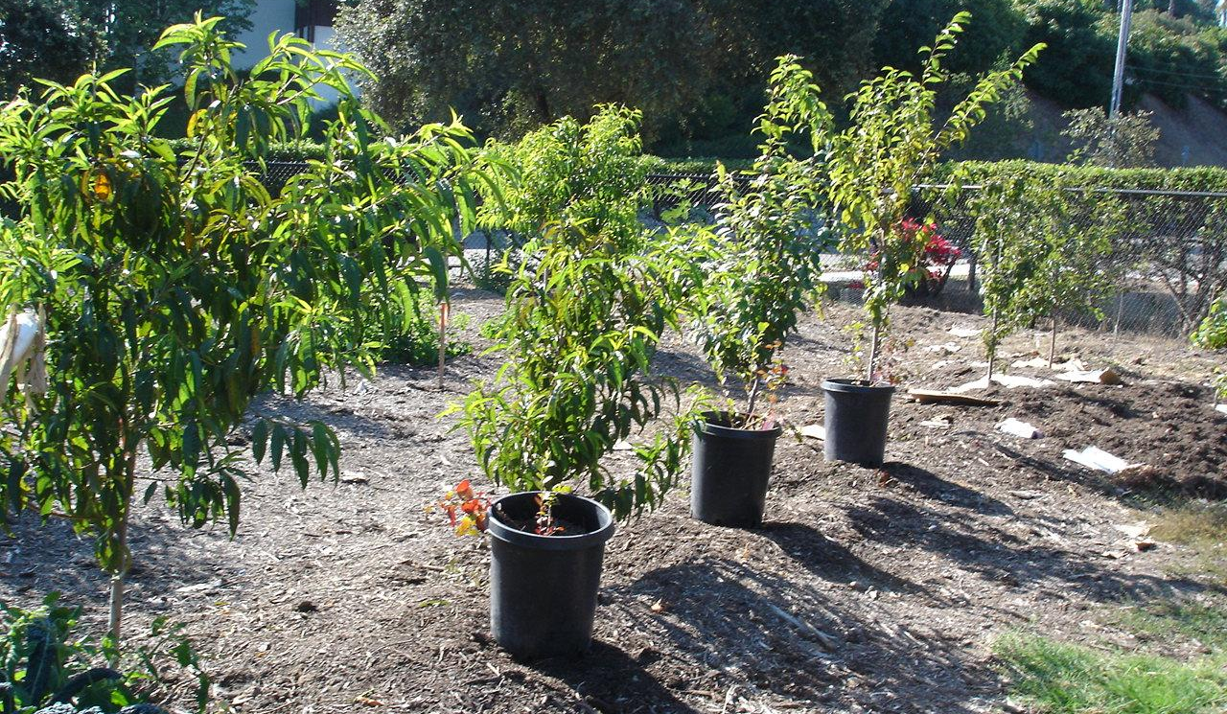
2010: PLANTING FIRST TREES

Slide 14
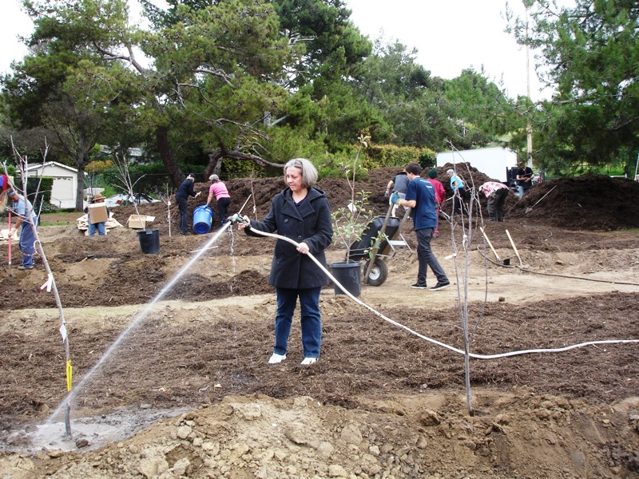
2010: WATERING NEW TREES

Slide 15
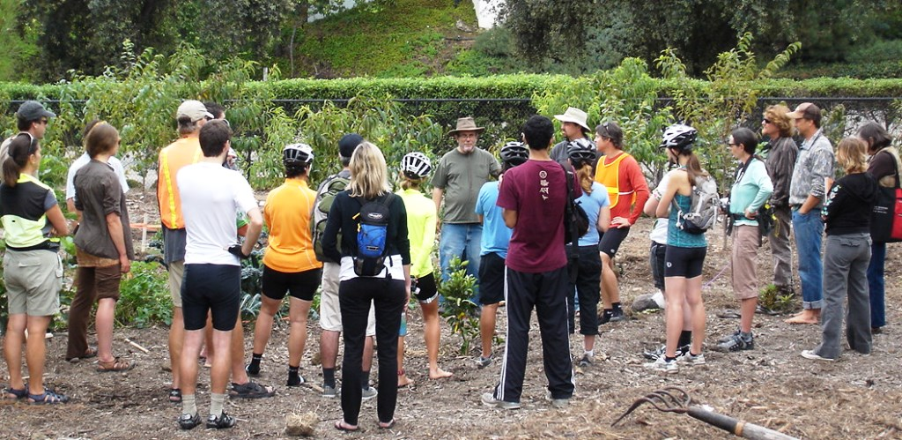
2011:EDUCATIONAL PROGRAM INITIATED
Notes:
As well as producing food, we see the Garden as a tremendous educational resource: for local schools, college students and community members. By visiting the garden, and participating in its growth and development, we believe that young and old alike can learn the joy of growing and sharing their own food. These activities bring people together in a spirit of cooperation and help to build healthy, resilient communities.

Slide 16
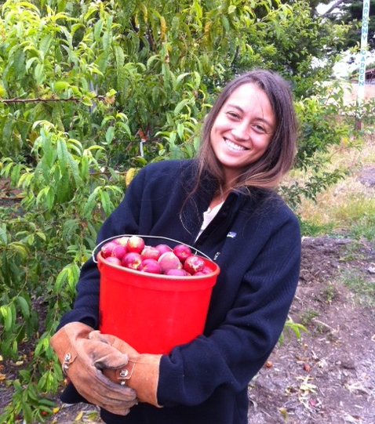
2012:FIRST HARVEST TO FOODBANK

Slide 17
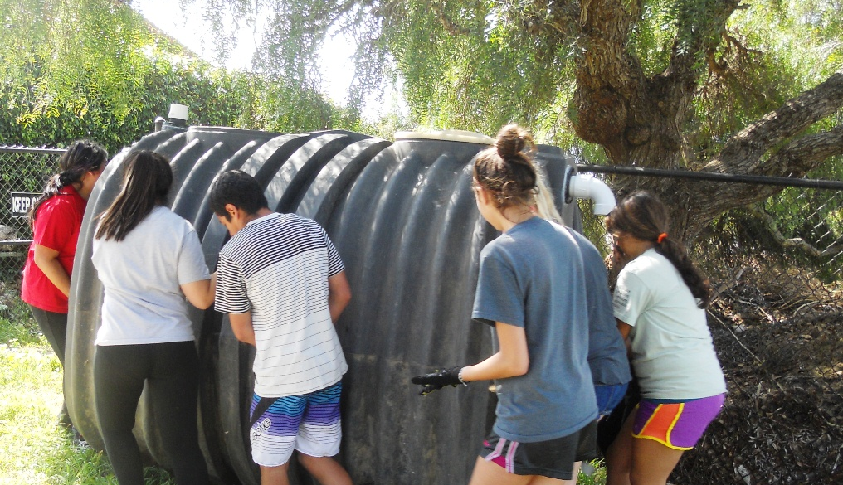
2013: ORFALEA VOLS INSTALL RAINWATER TANK

Slide 18
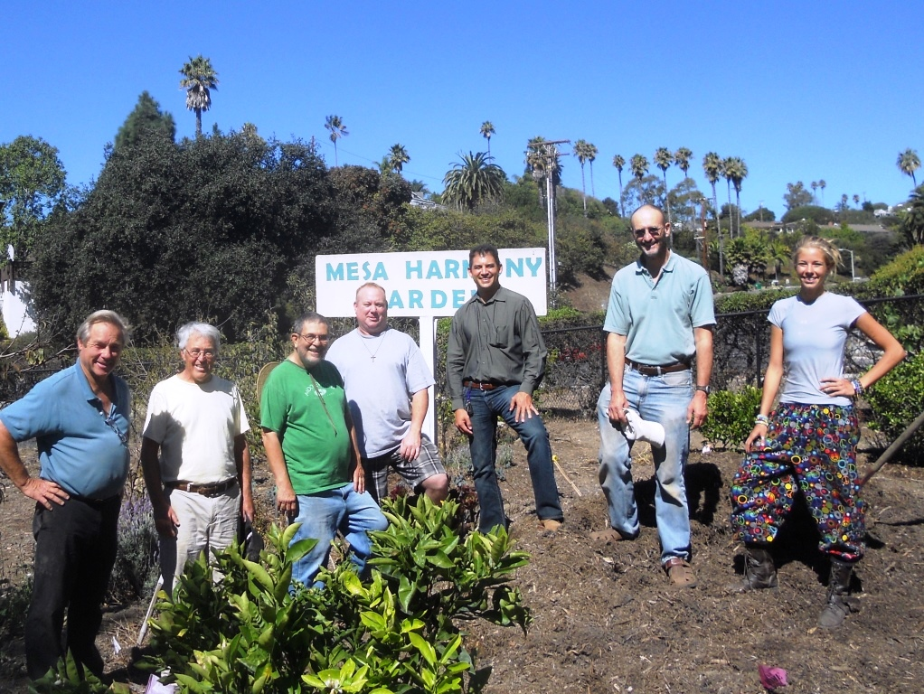
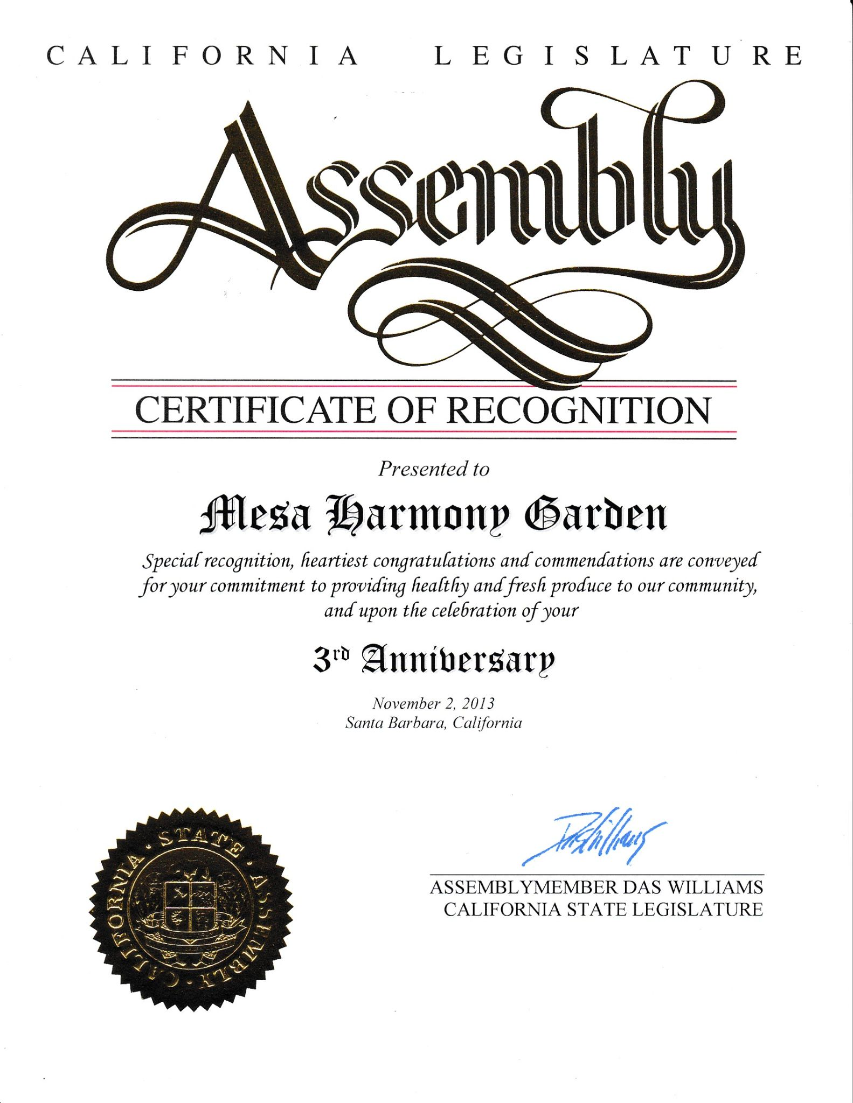
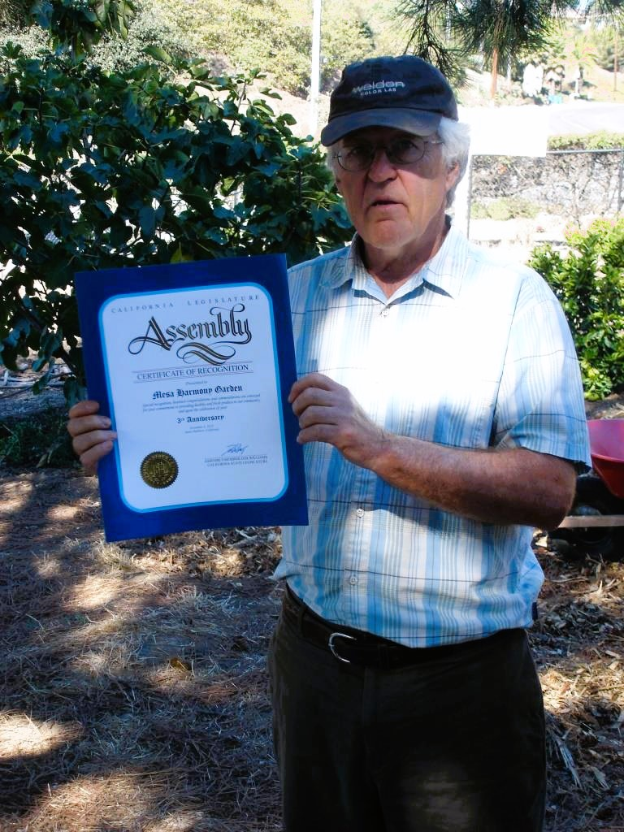
2013 Certificate of Recognition for providing healthy and fresh produce to our community and celebration of our 3rd Anniversary
Assemblymember Das Williams

Slide 19
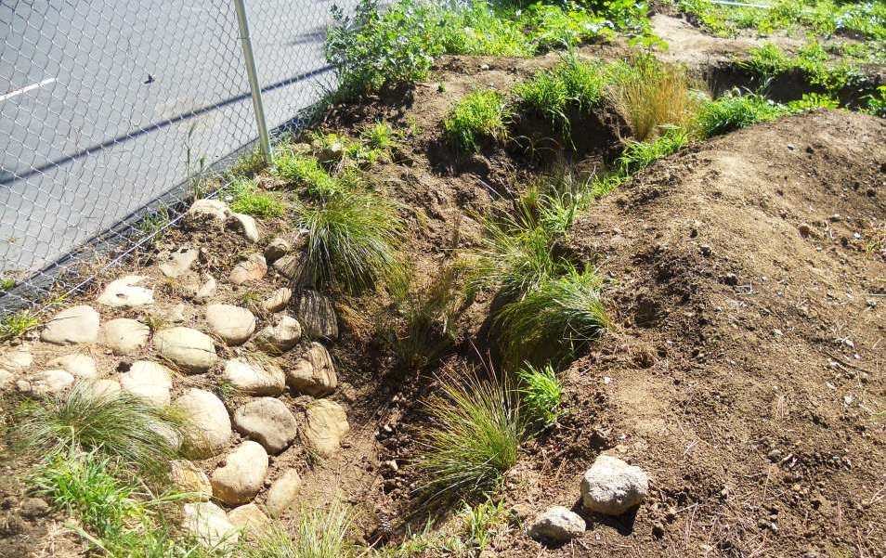
2013: AMERICORPS VOLUNTEERS DIG BIOSWALE

Slide 20
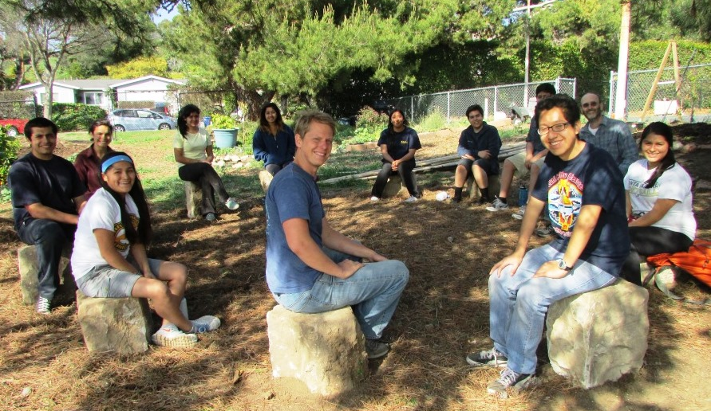
2014: OUTDOOR CLASSROOM CREATED

Slide 21
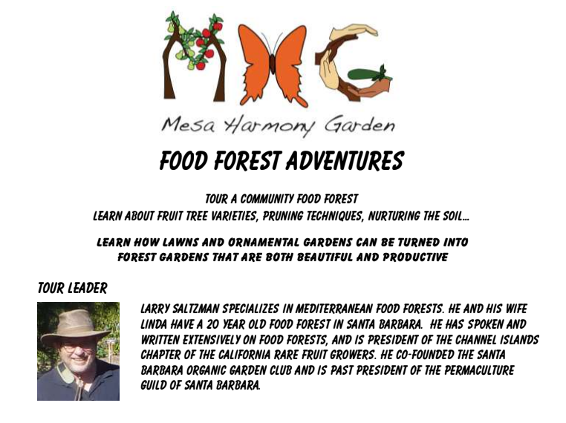
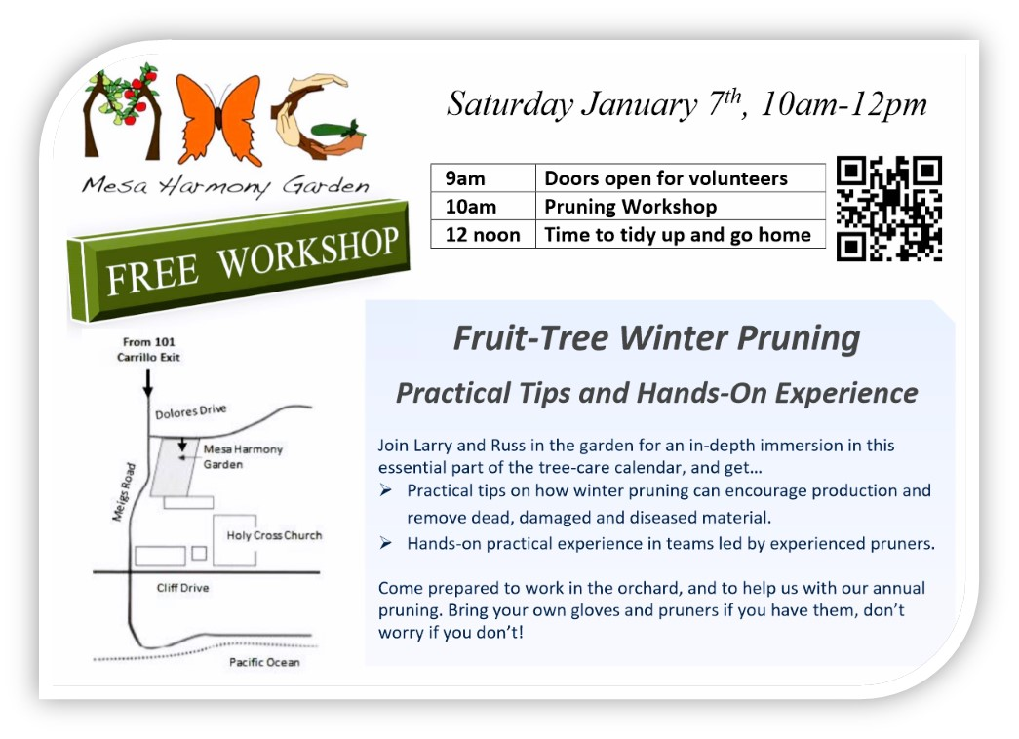
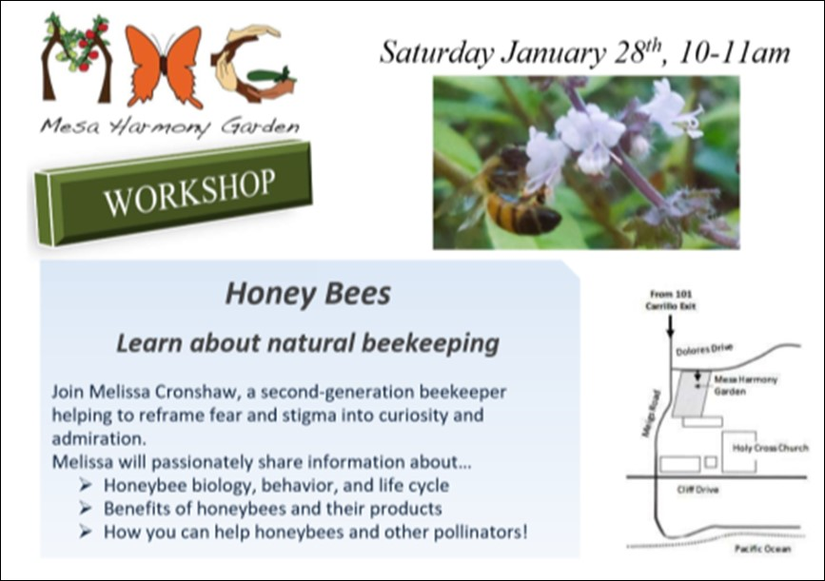
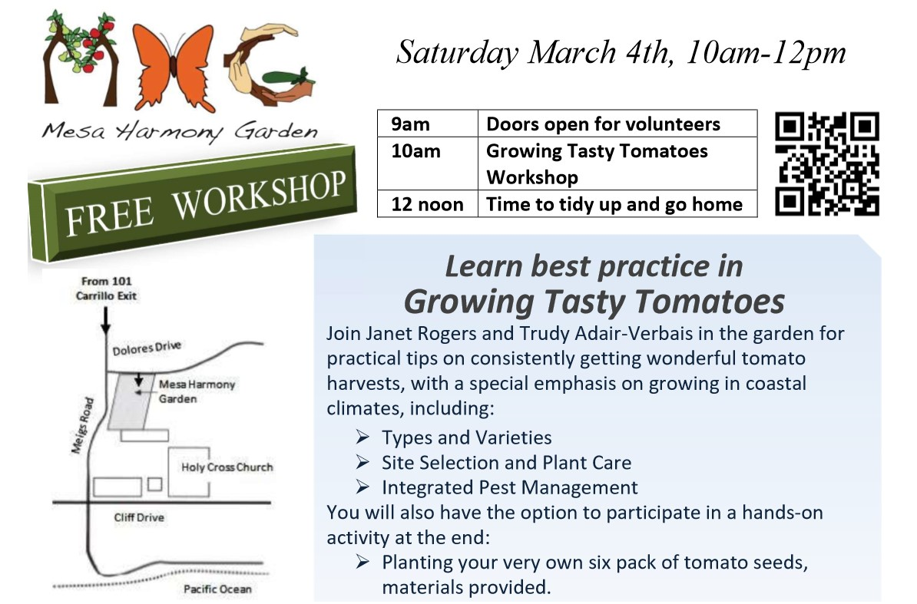
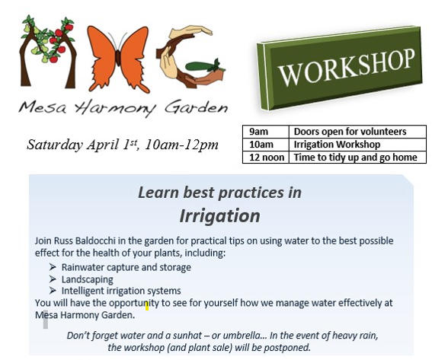
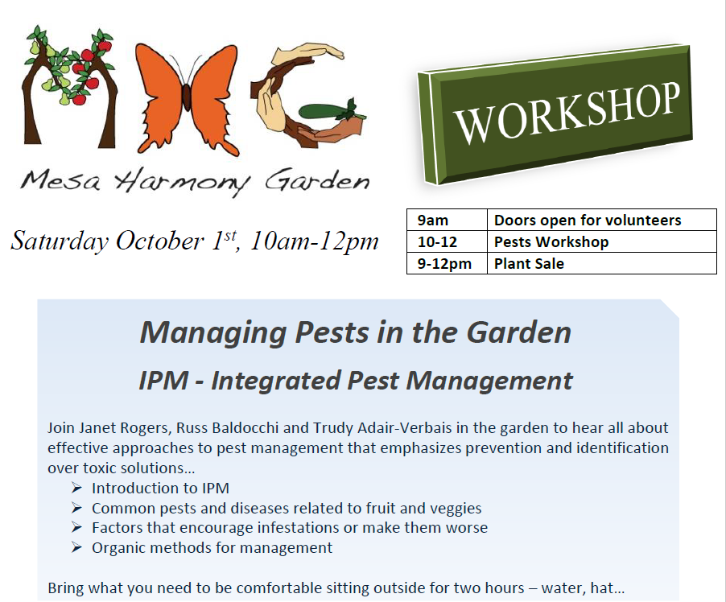
The Classroom is well used! - a sampling of flyers

Slide 22
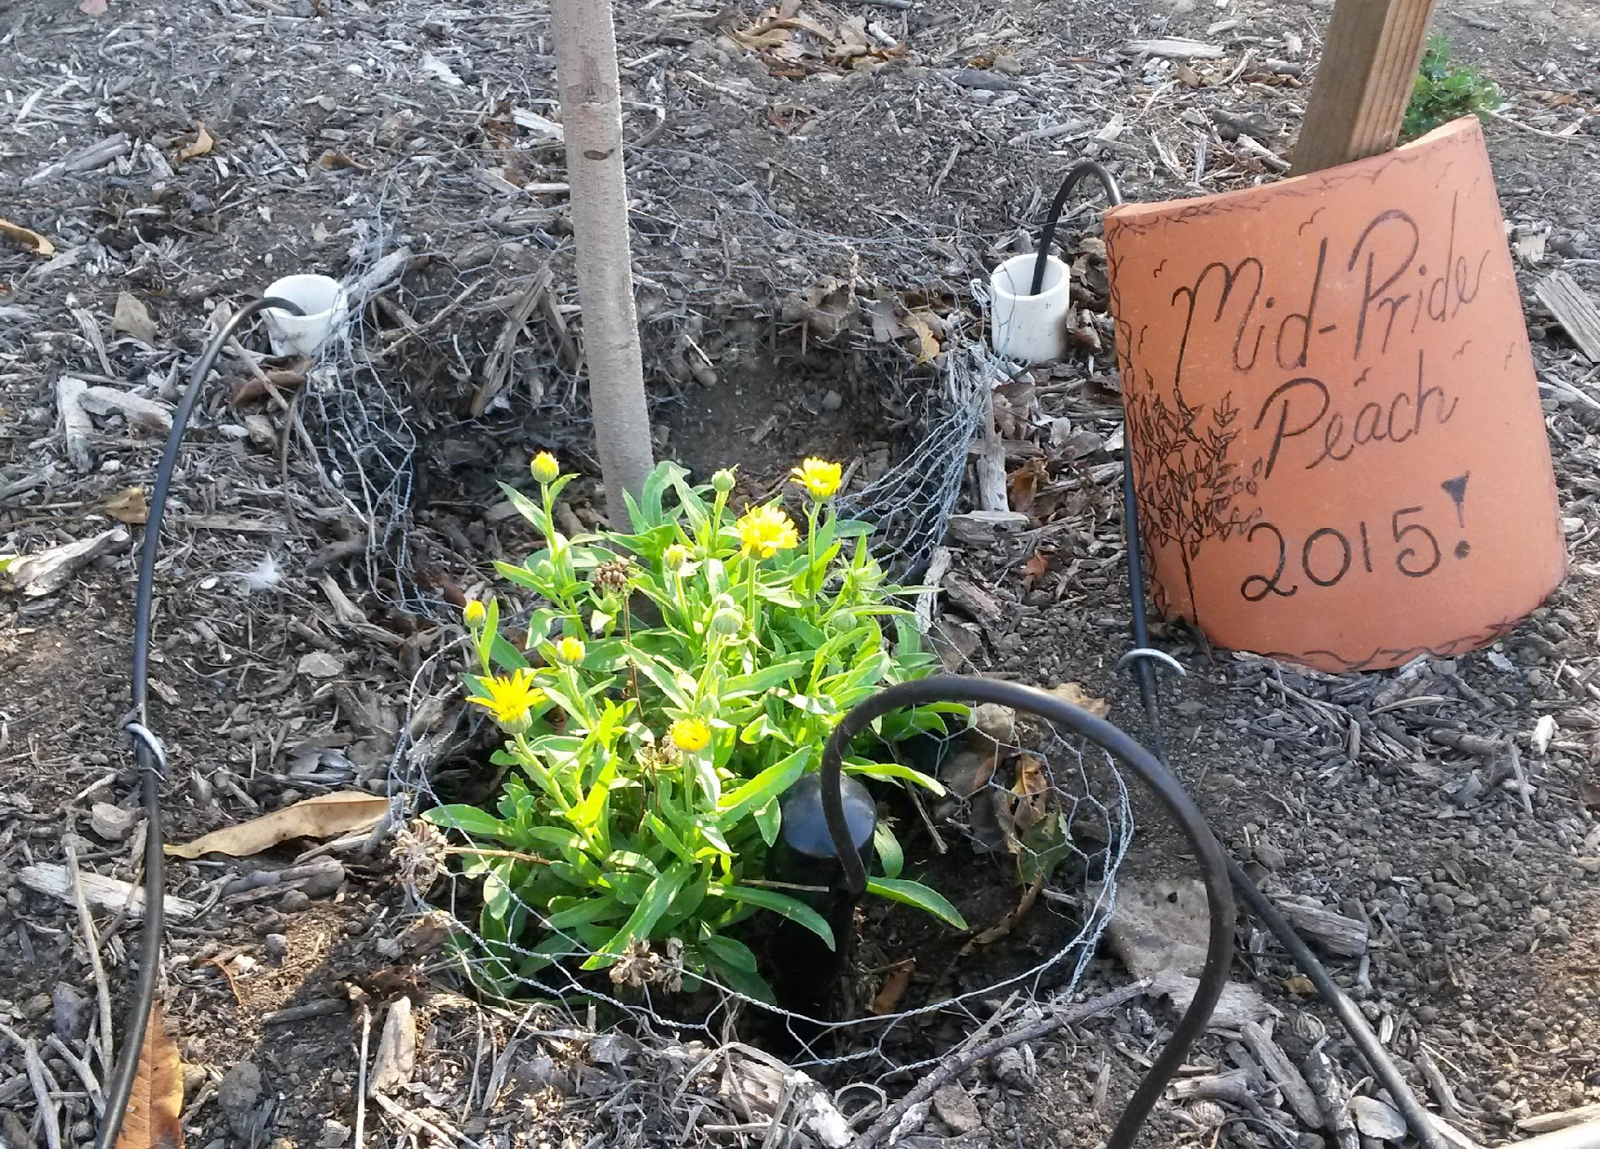
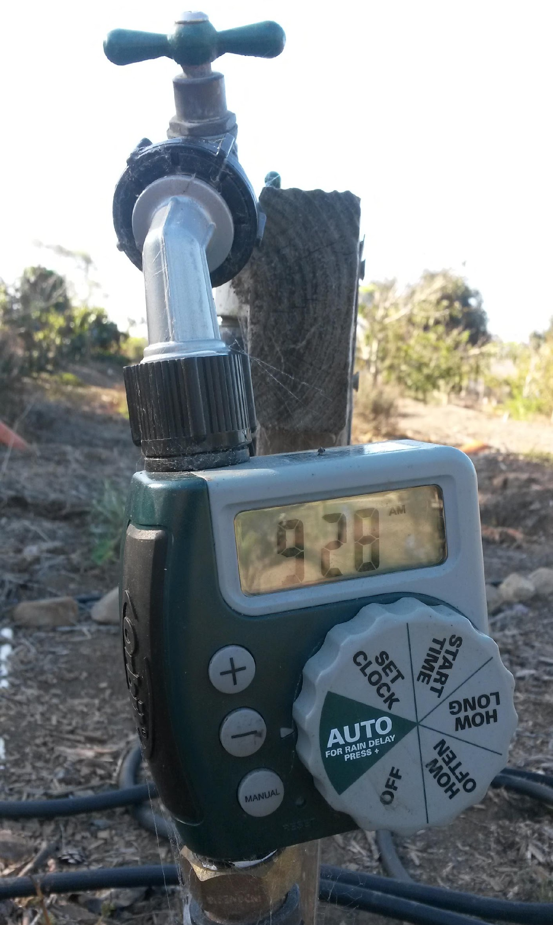
2015:DEEP DRIP IRRIGATION INSTALLED

Slide 23
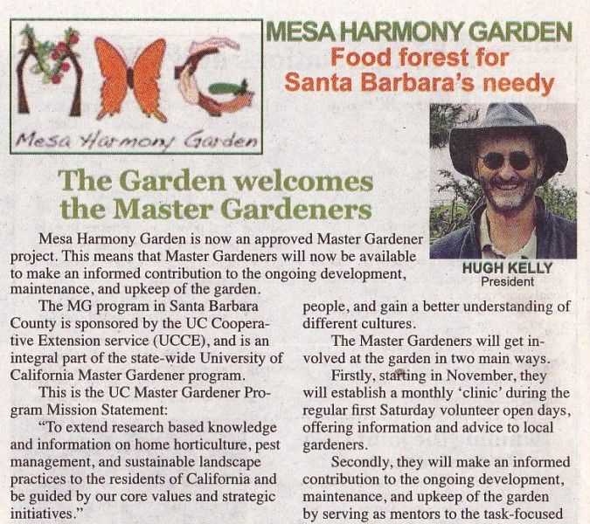
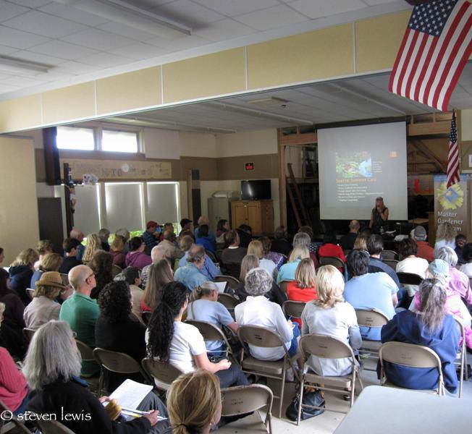
2015: ADOPTED BY MASTER GARDENER PROGRAM

Slide 24
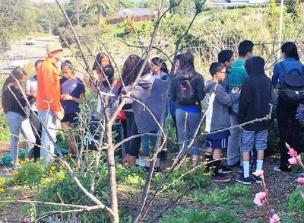
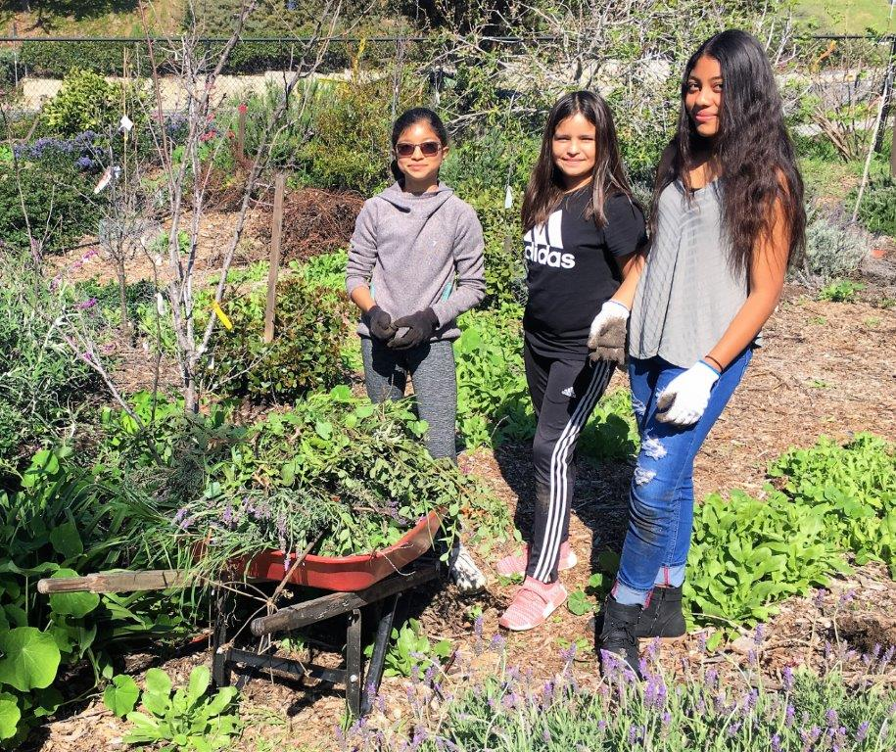
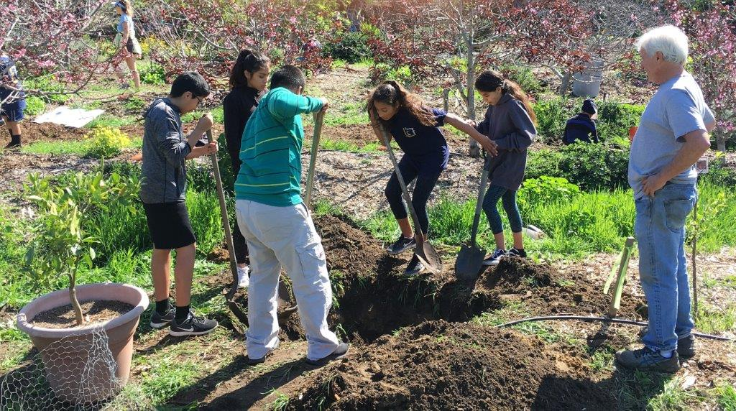
YOUTH EDUCATION COMPONENT
Kids often come with parents
High school students fulfill community service
College students fulfill community interaction requirements
Student groups

Slide 25
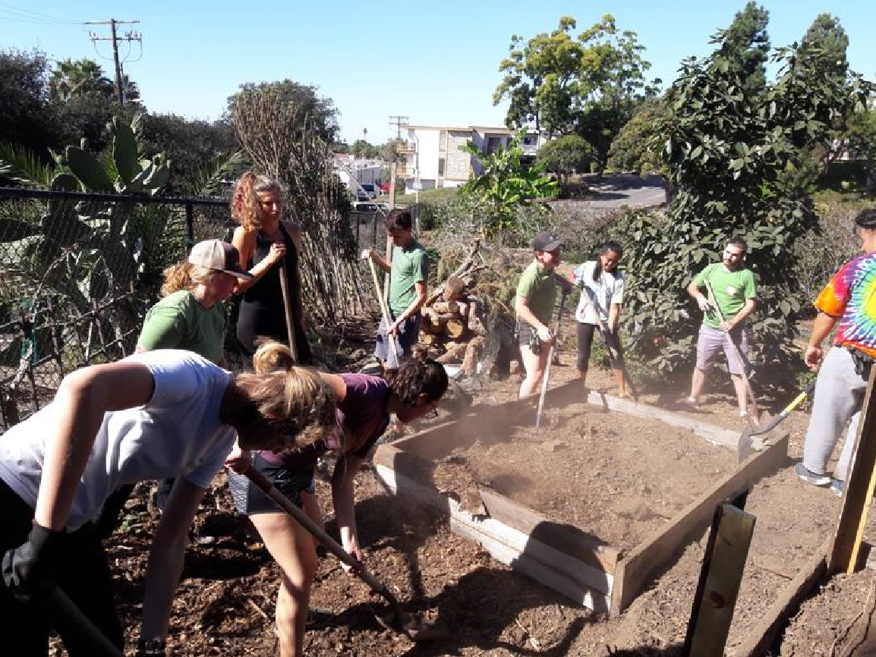
2018: RAISED BEDS DONATED
Notes:
Neighbors donated some raised beds that they no longer needed, and students from UCSB came in and installed them for us…

Slide 26
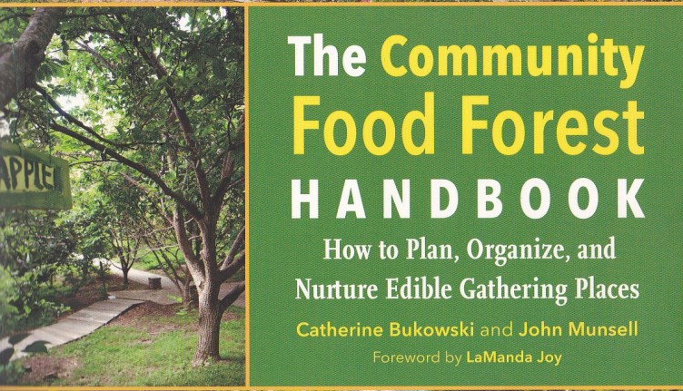
2018: GARDEN REFERENCED IN NEW BOOK

Slide 27
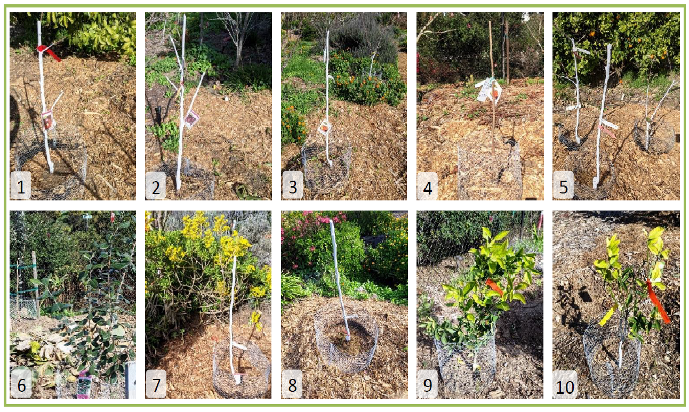
(2019 and on-going)NEW TREES PLANTED
Burgundy Plum
Flavor King Pluot
Fuju Persimmon
Fuju Persimmon
Apple trees, sharing hole (Golden Delicious, Gala, and multi-graft: Fuji + Yellow Bellflower
2x Pineapple Guavas
Monterey Pear
Monterey Pear
Washington Navel Orange
Washington Navel Orange

Slide 28
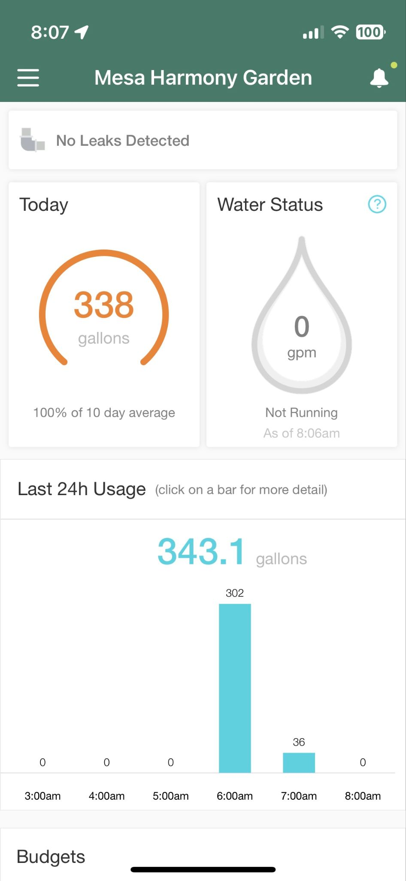
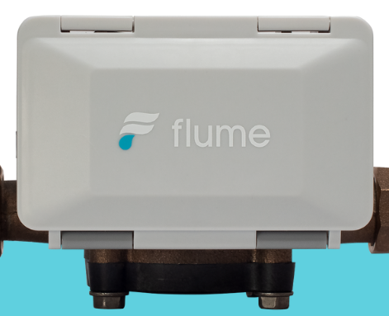
2021 Flume Technology added
Water leak led to the addition of a water monitoring system -

Slide 29
2021 - SBEE received the Golden Leaf Award from Santa Barbara Beautiful.
SBEE is a collaboration between the SBCC Foundation, Explore Ecology and five community partners - including Mesa Harmony Garden and the SB Botanic Garden.
Notes:
The SBEE collab. received an award of $100,000 from the EPA in 2021 to assist in education around the critical issues of ecological health, water conservation, restoration of native habitat and biological communities, and the production of local, healthy food.

Slide 30
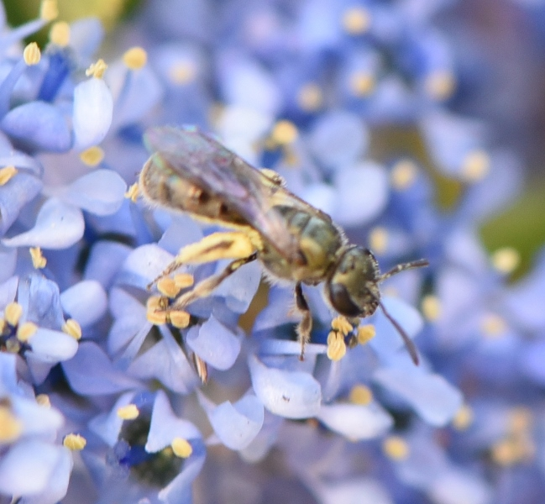
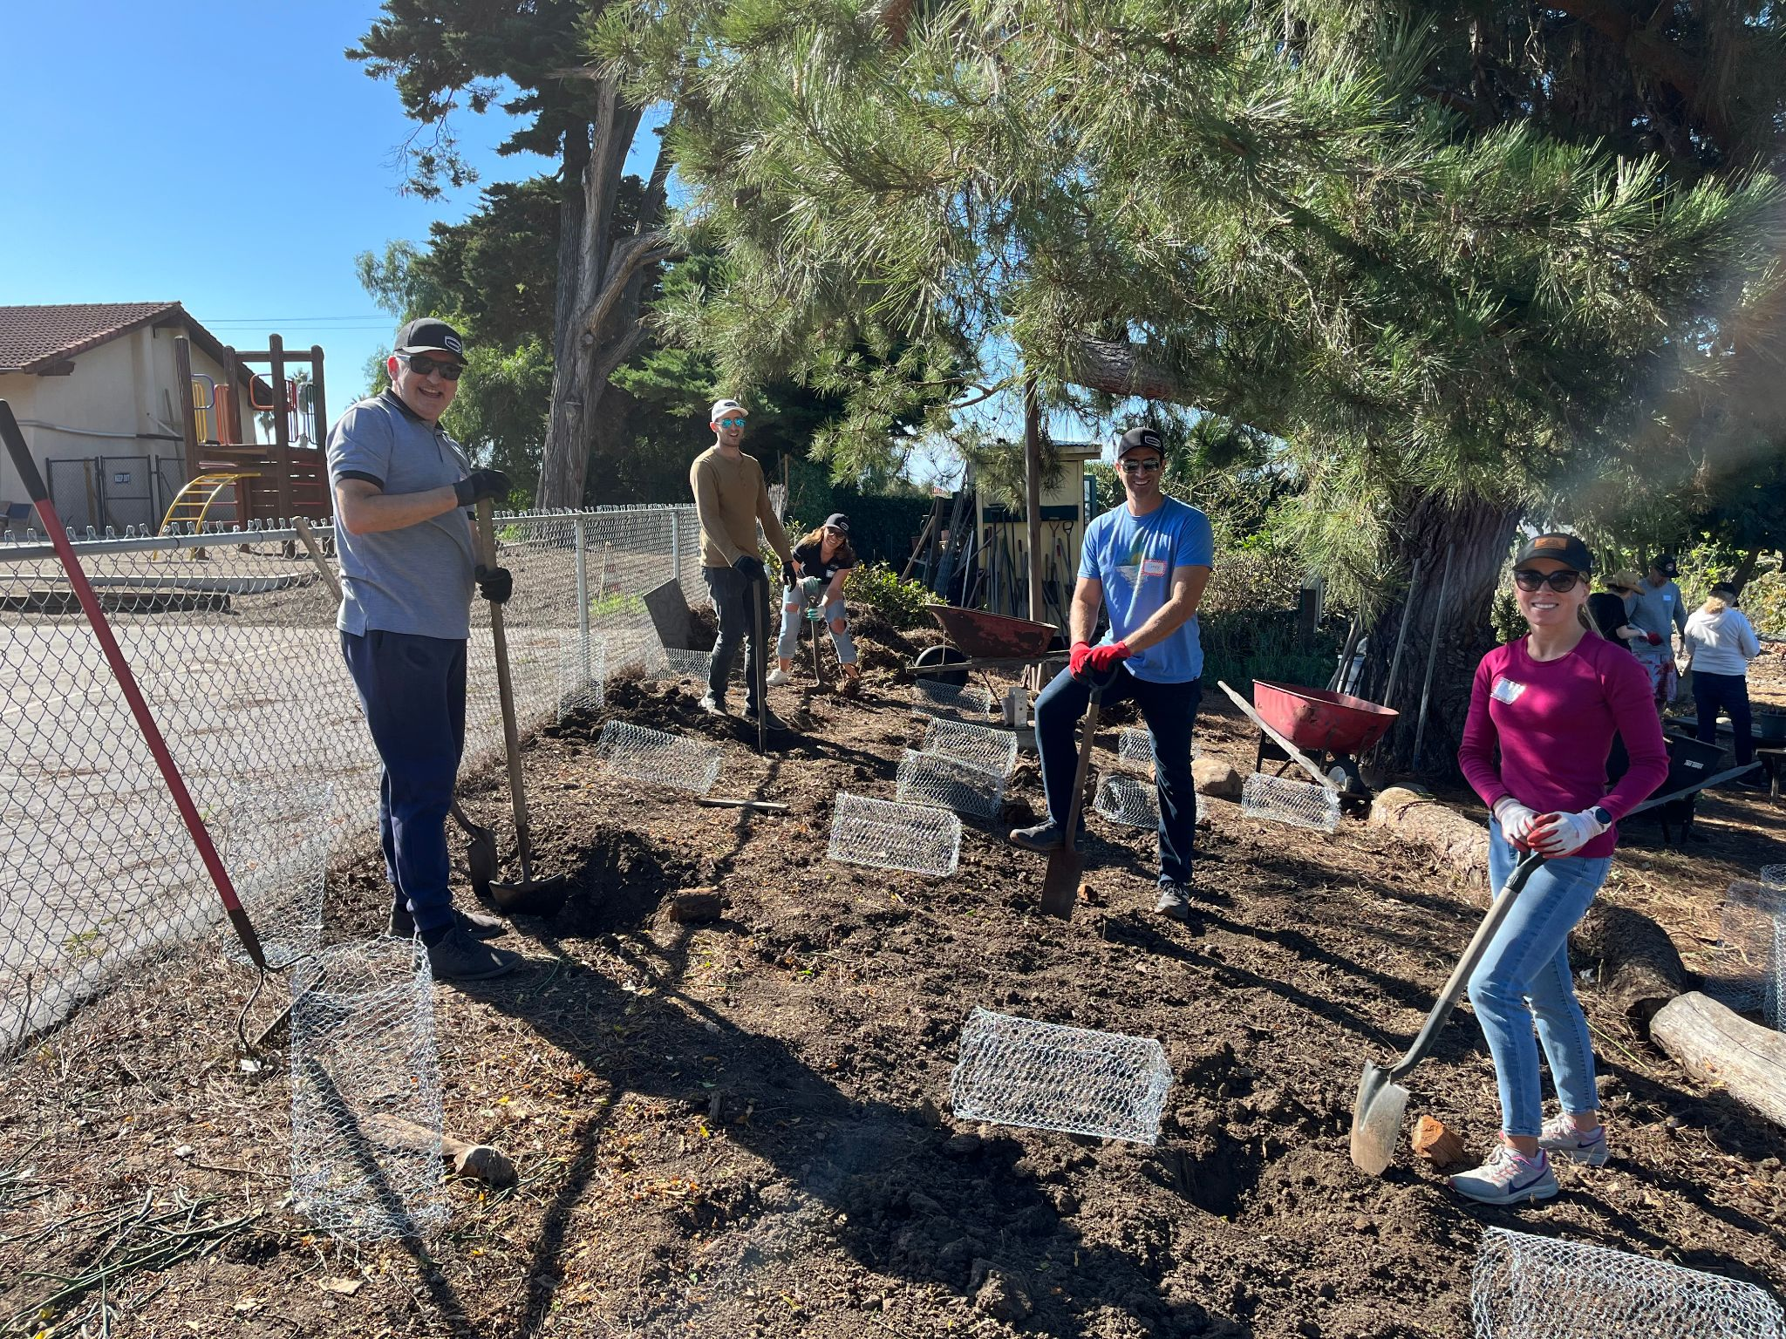
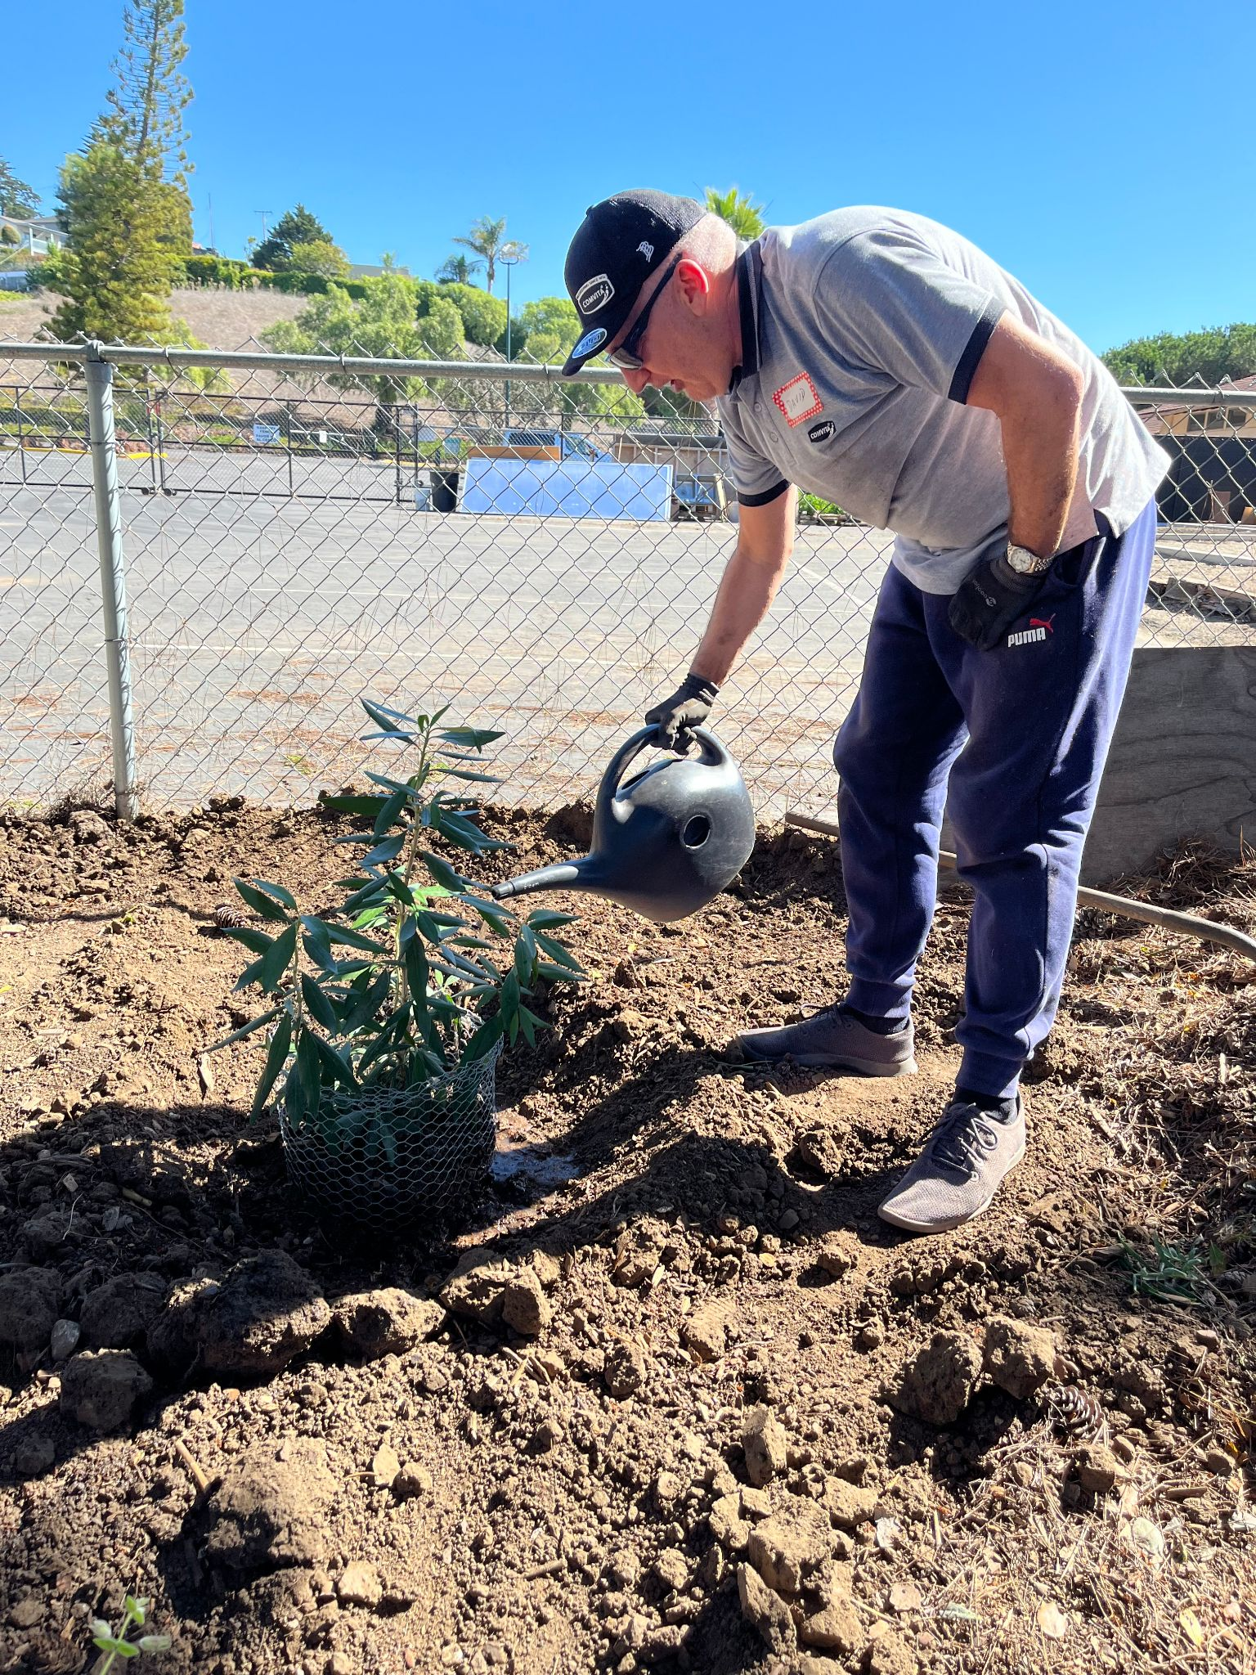
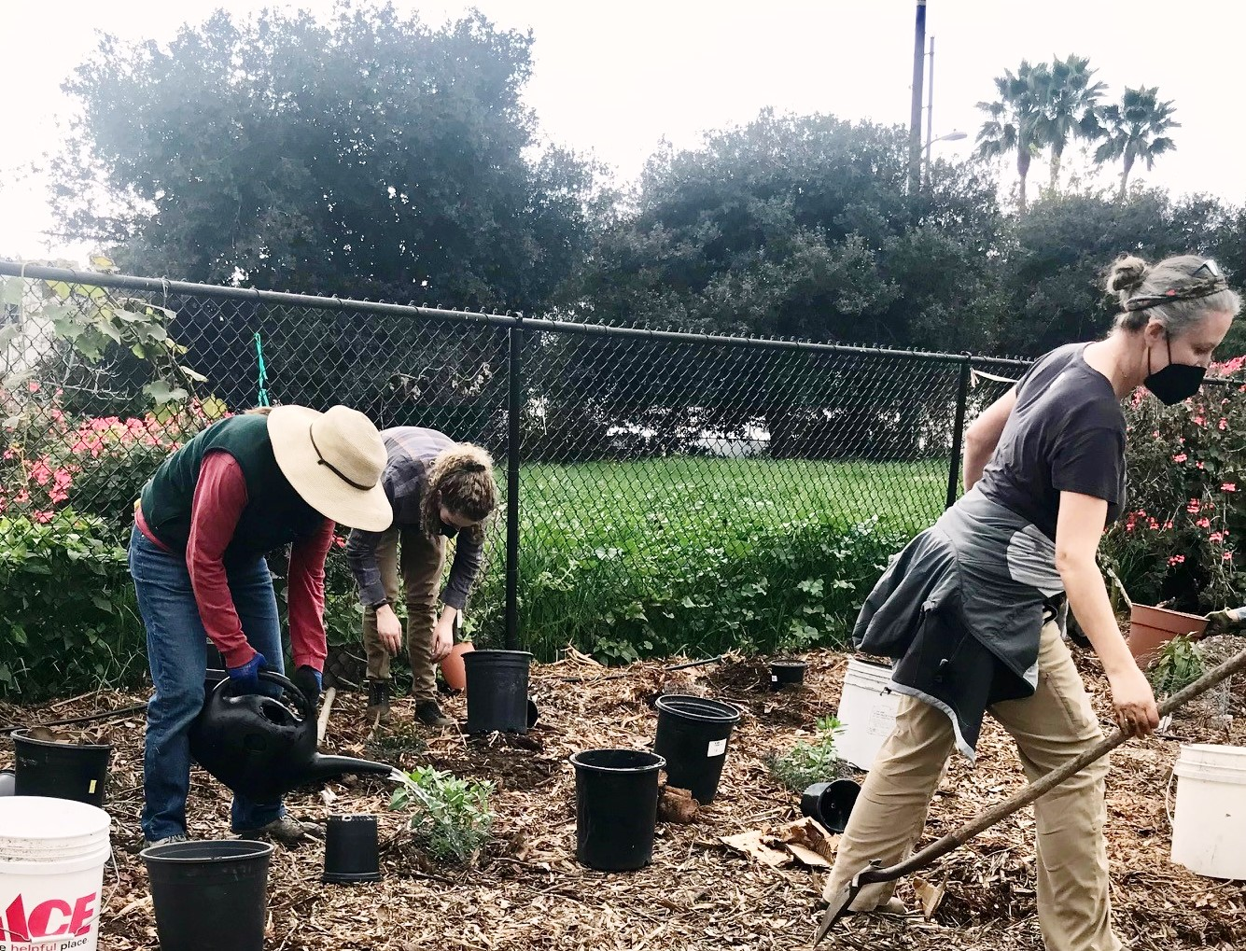
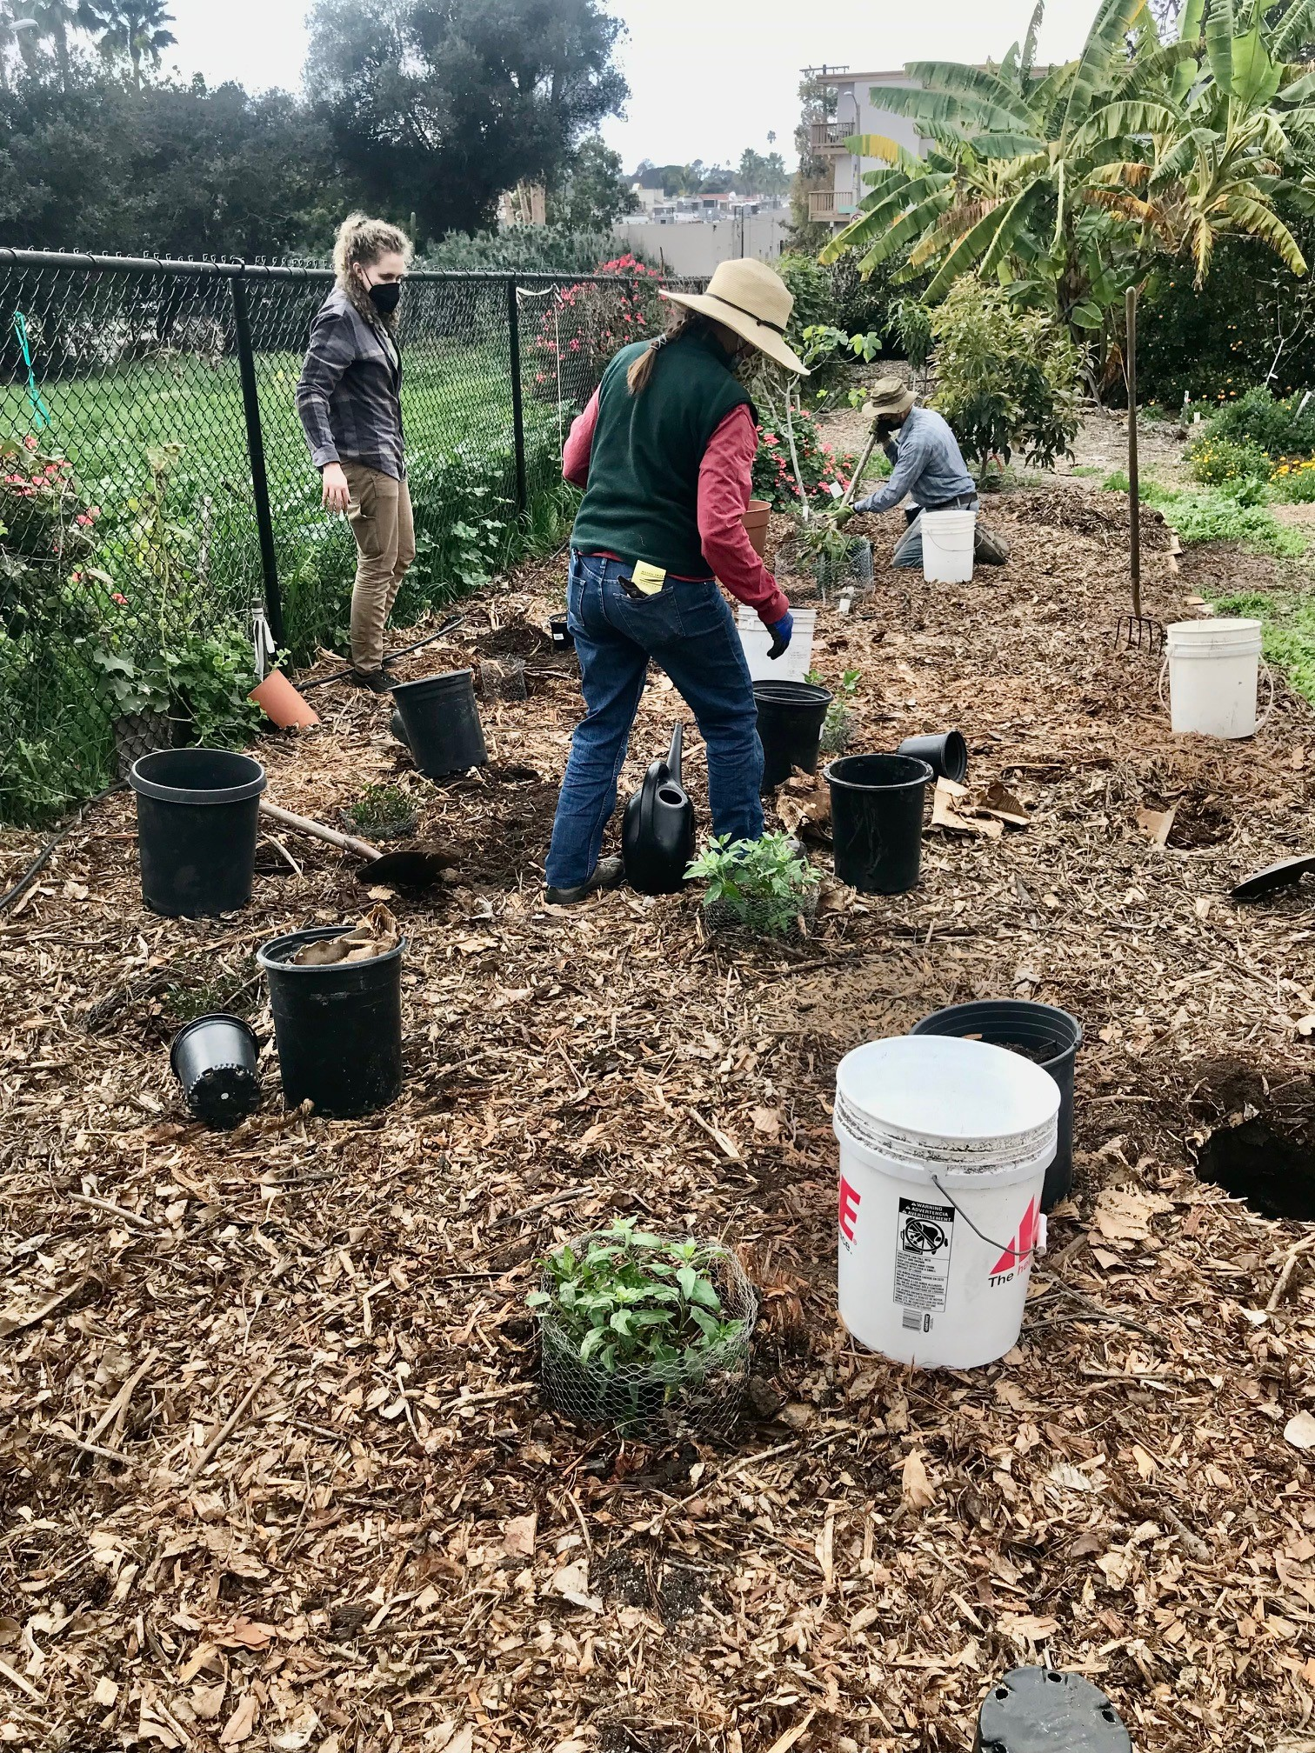
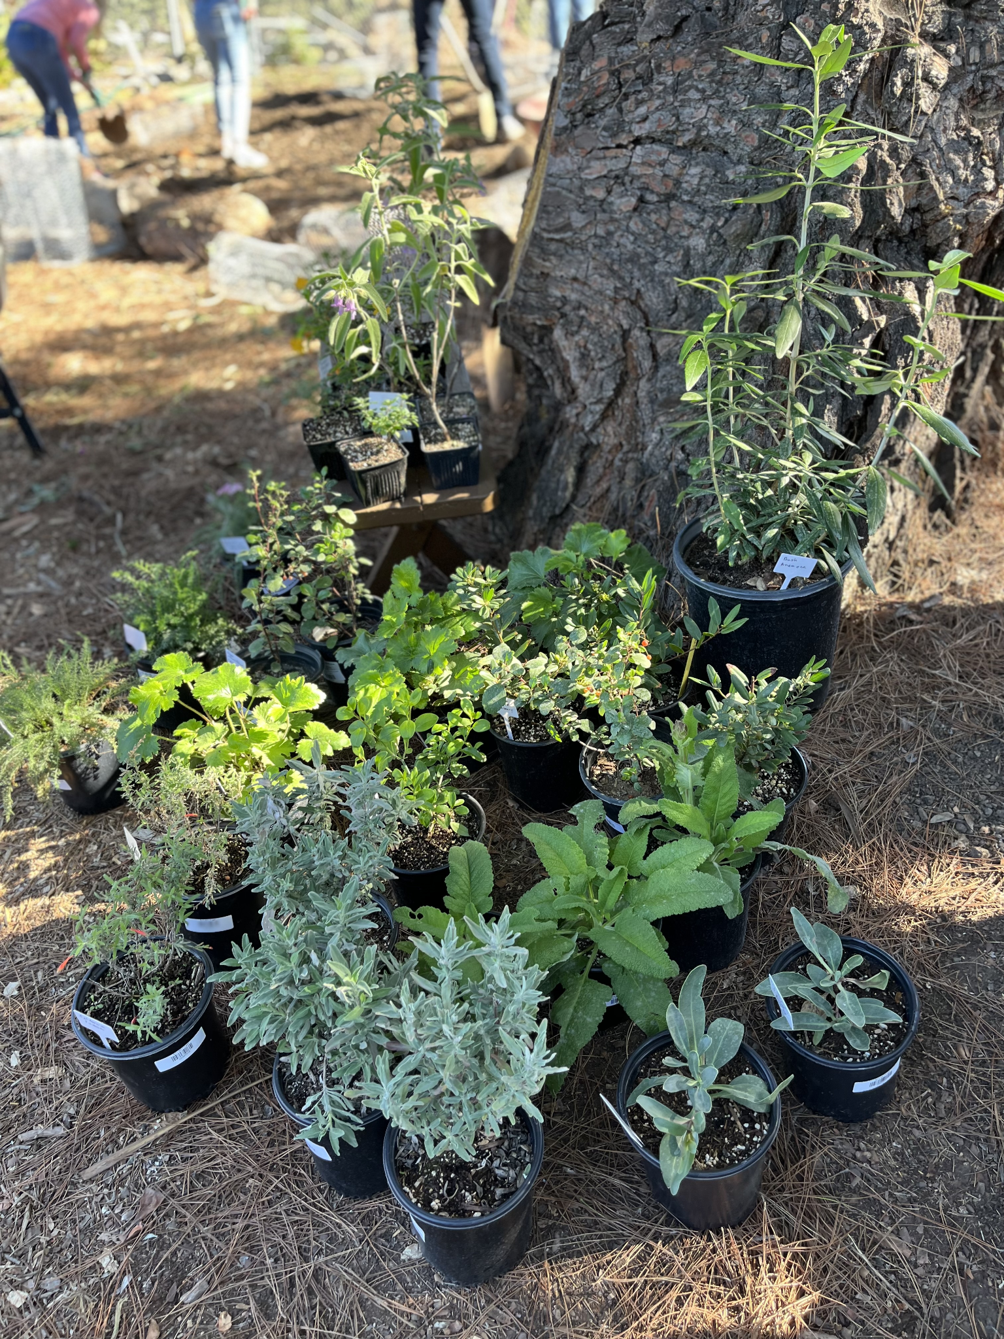
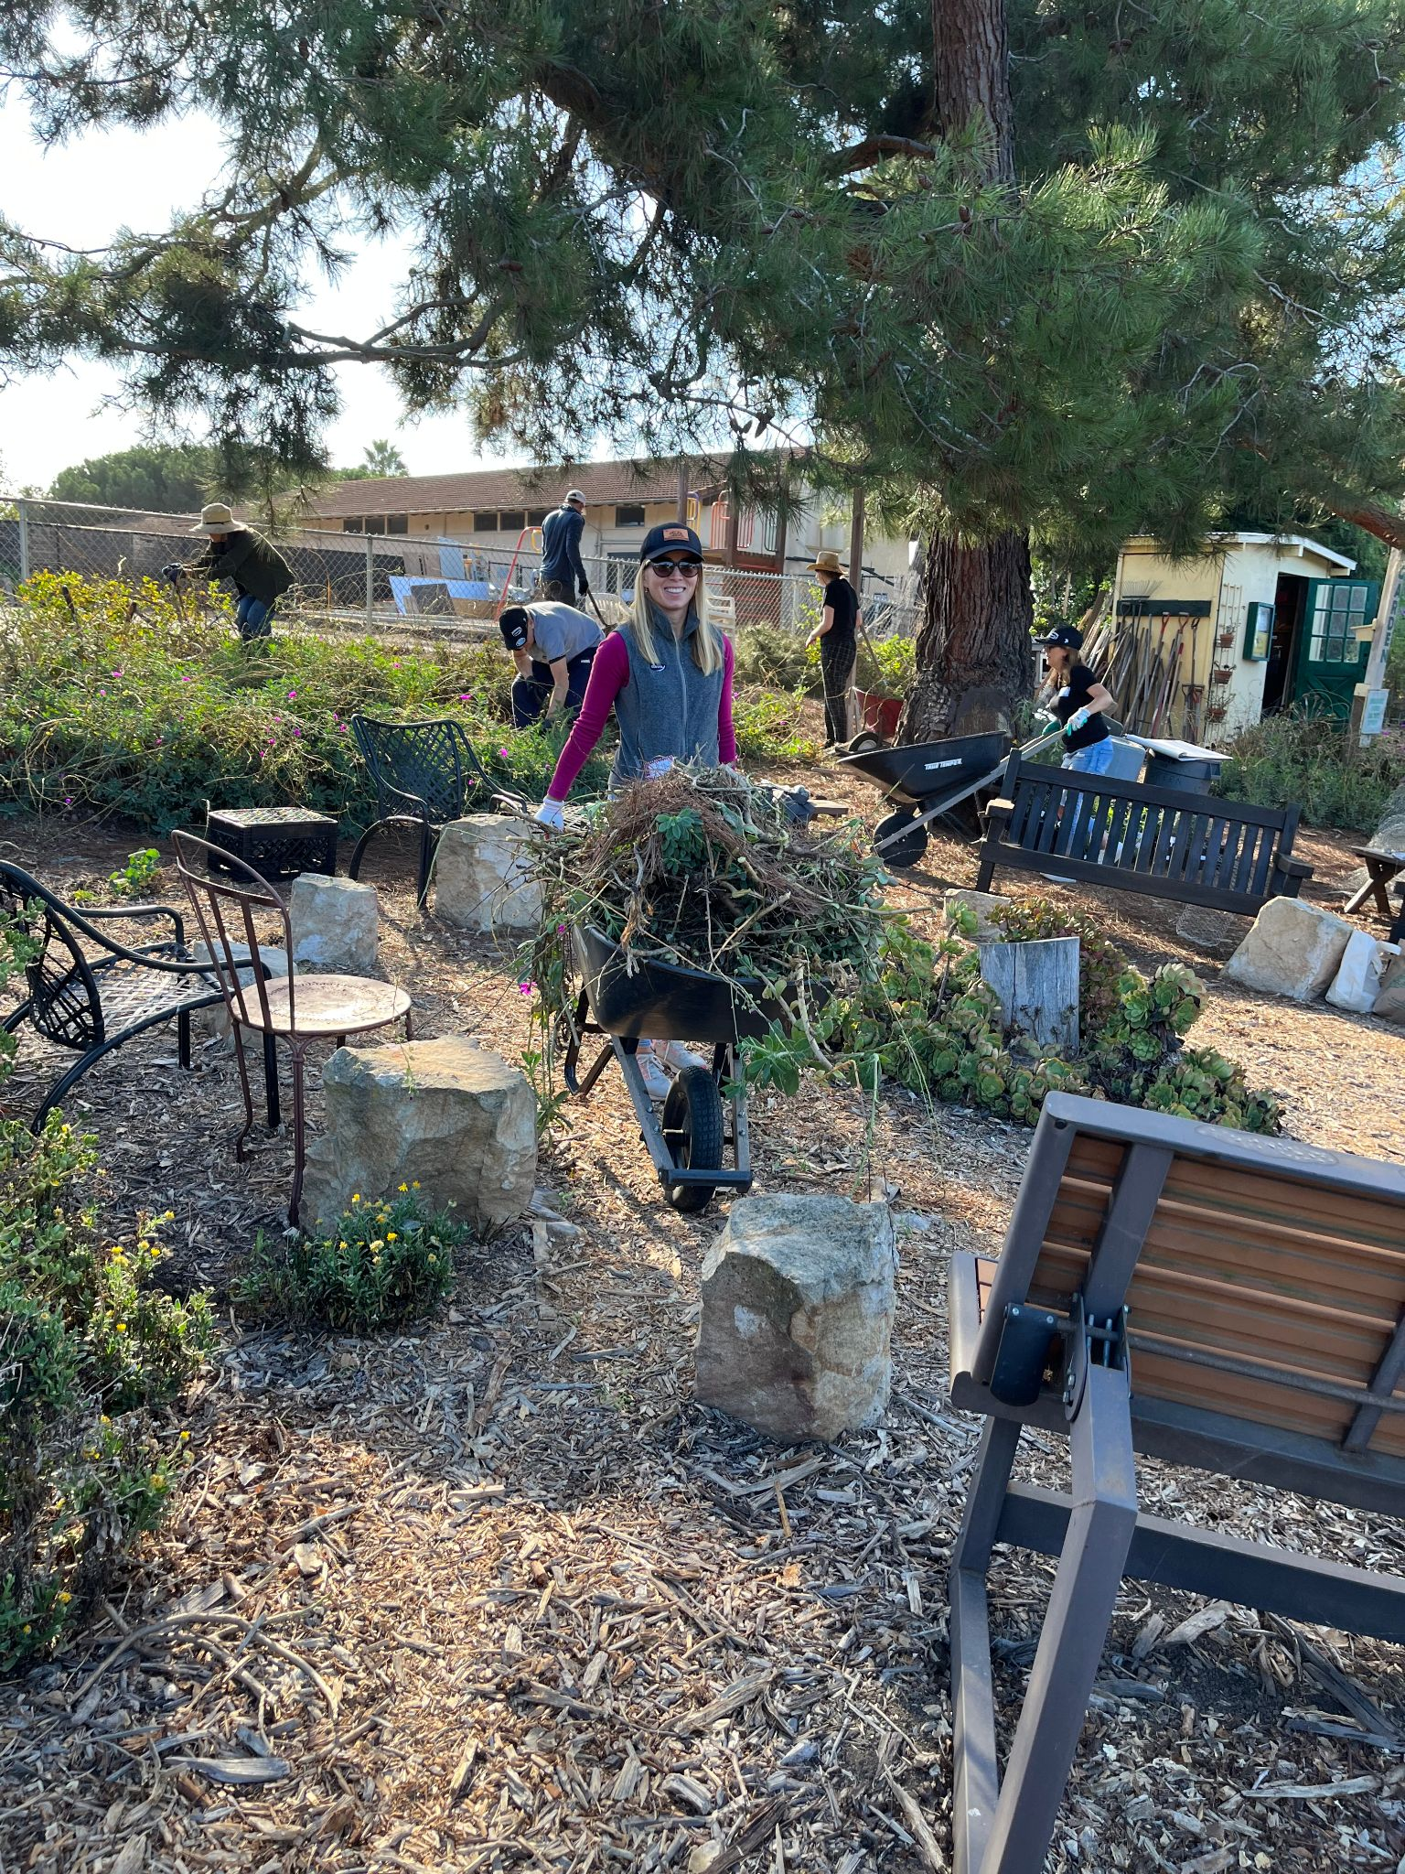
2022 Native Plant Garden added
Comvita (makers of Manuka Honey) Team-Building Day: Provided donation to purchase plants. Helped to remove succulents and small trees from area. Helped dig holes, build gopher cages, plant pollinator-attracting natives, and water!
Photo Credits Kylie Etter - SB Botanic Garden

Slide 31
Over 20 species of pollinator-attracting natives selected!
Sticky Monkey Flower
Manzanita
Toyon
Redflower Buckwheat
Goldenrod
Cleveland Sage
Notes:
What the pollinators can look forward to ^^^

Slide 32
Today!

Slide 33
2023 - Bioreactor Project

Slide 34
Visit us in June 2024 to see the results!

Slide 35
THE BIG PICTURE
Forests are increasingly viewed as a key response to numerous environmental crises
It makes sense to source as much food locally as we can: more fresh food, less food miles
Social justice is served by making fresh local produce available to all members of the community

Slide 36
SOME NUMBERS
Over 13 years since the program was initiated
Over 5000 volunteer hours to improve and maintain the property
Last year, nearly 1800 Lbs of fresh produce delivered to the Food Bank

Slide 37
JOIN US ONE SATURDAY MORNING TO TAKE A STROLL, TAKE A TOUR, OR BRING YOUR GLOVES AND PITCH IN!!

Slide 38
HARMONY GARDENS –WORKING TOGETHER

Slide 39
Photo Credits Kylie Etter - SB Botanic Garden

